Slide 1

Home Sales Austin & SA VS. The US
Aaron Eger
Christopher Stecki
Robert Allison
Jordan Telley

Slide 2

What We Will Cover
We will be looking at the home sales of Austin and San Antonio from 2008 through now and compare it to the national sales during the same time period.

Slide 3
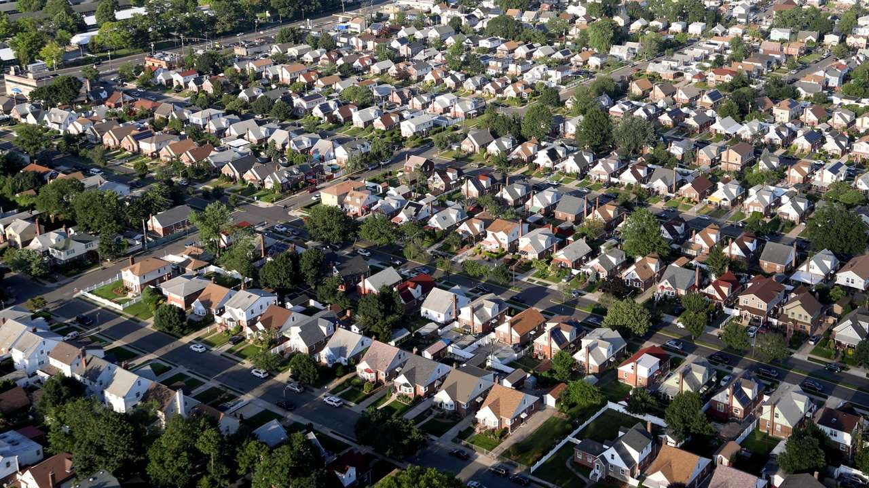
Increase In Price

Slide 4

Austin VS The US

Slide 5

San Antonio VS The US

Slide 7


Slide 8


